Slide 1
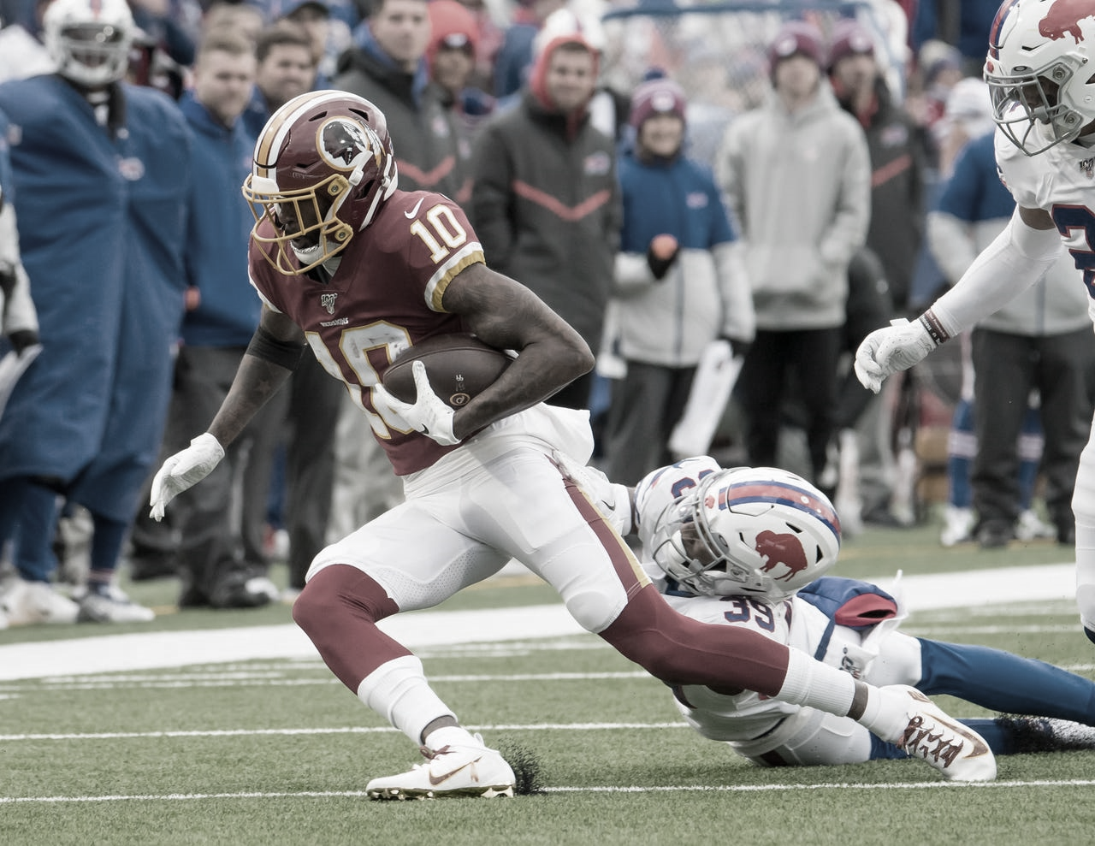

N F L
BASIC PLAYER INFORMATION
By SomnambWl

Slide 2

NAMA KELOMPOK TUGAS MACHINE LEARNING
ANDIKA RAMADHAN - 1151700004
ALIF RIZKY - 11517000
FAJAR GUNAWAN - 11517000
SYEHABUDIN ARDI . G - 11517000
NFL - BASIC PLAYER INFORMATION

Slide 3
INTRO
Note book ini hanya menjelaskan tentang EDA (Exploratory Data Analysis) dari setiap atribut pemain yang ada pada dataset yang diberikan, seperti umur, tinggi, berat badan, dsb.
NFL - BASIC PLAYER INFORMATION

Slide 4
BACA DATA DATASET
plays = pd.read_csv("../input/nfl-big-data-bowl-2020/train.csv")
# Get players out of dataset of plays and rename columns
players = plays[["DisplayName", "PlayerHeight", "PlayerWeight", "PlayerBirthDate", "PlayerCollegeName"]].drop_duplicates()
players.rename(columns={"DisplayName":"Name", "PlayerHeight": "Height", "PlayerWeight": "Weight", "PlayerBirthDate":"BirthDate", "PlayerCollegeName":"College"}, inplace=True)
# Transfer to SI units
players["Weight"] = players["Weight"] * 0.45359237 # In kilograms
players["Height"] = players["Height"].str.split("-", expand=True)[0].astype() * 30.48 + players["Height"].str.split("-", expand=True)[1].astype() * 2.54 # in centimeters
# Set birthdate column as datetime and add age in years
players["BirthDate"] = pd.to_datetime(players['BirthDate’])
players["Age"] = (pd.Timestamp('20191010') - players["BirthDate"]).dt.days / 365 # In years
# Compute body mass index (BMI) and add classification
players["BMI"] = players["Weight"] / (players["Height"] / 100)**2 # Weight has to be in kilograms, height in meters (factor 100 to transfer from centimeters)
players["ObesityClassification"] = pd.cut(players["BMI"], bins=[0, 18.5, 25, 30, 35, 40, 100], labels=["Underweight", "Normal weight", "Pre-obesity", "Obesity class 1", "Obesity class 2", "Obesity class 3"])
players
NFL - BASIC PLAYER INFORMATION

Slide 5
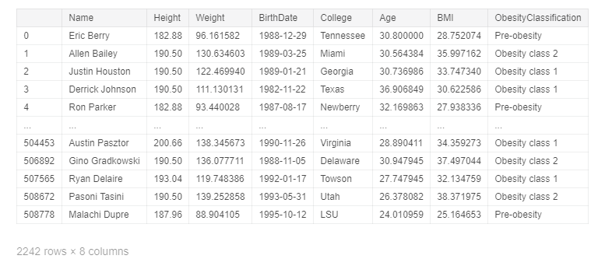
DATA PADA DATASET
NFL - BASIC PLAYER INFORMATION

Slide 6
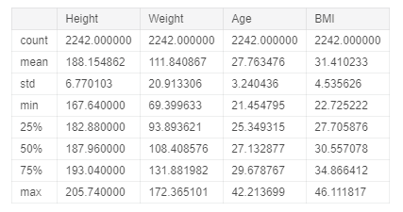
RANGKUMAN DATA
players.describe()
NFL - BASIC PLAYER INFORMATION

Slide 7
RANGKUMAN DATA
Dari tabel rangkuman data tersebut, dapat disimpulkan :
Jumlah pemain = 2242 pemain
Rata – rata umur pemain = 27, 75 tahun
Rata – rata tinggi pemain = 188, 2 cm
Rata – rata berat pemain = 111, 8 kg
Pemain termuda = 21, 45 tahun
Pemain tertua = 42, 21 tahun
Pemain dengan berat tubuh teringan = 69, 4 kg
Pemain dengan berat tubuh terberat = 172, 37 kg
Pemain terpendek = 167, 64 cm
Pemain tertinggi = 205, 74 cm
NFL - BASIC PLAYER INFORMATION

Slide 8
RANGKUMAN DATA
Print(f"Players are from {len(players['College'].unique())} different colleges.")
Print(f"The youngest player is {players.loc[players['Age'] == players['Age'].min(), 'Name'].values[0]} with age {round(players['Age'].min(), 2)} years from
{players.loc[players['Age'] == players['Age'].min(), 'College'].values[0]}.")
Print(f"The oldest player is {players.loc[players['Age'] == players['Age'].max(), 'Name'].values[0]} with age {round(players['Age'].max(), 2)} years from
{players.loc[players['Age'] == players['Age'].max(), 'College'].values[0]}.")
Print(f"The most lightweight player is {players.loc[players['Weight'] == players['Weight'].min(), 'Name'].values[0]} with weight {round(players['Weight'].min(), 2)} kg from
{players.loc[players['Weight'] == players['Weight'].min(), 'College'].values[0]}.")
Print(f"The heaviest is {players.loc[players['Weight'] == players['Weight'].max(), 'Name'].values[0]} with weight {round(players['Weight'].max(), 2)} kg from
{players.loc[players['Weight'] == players['Weight'].max(), 'College'].values[0]}.")
Print(f"The shortest player is {players.loc[players['Height'] == players['Height'].min(), 'Name'].values[0]} with height {round(players['Height'].min(), 2)} cm from
{players.loc[players['Height'] == players['Height'].min(), 'College'].values[0]}.")
Print(f"The tallest player is {players.loc[players['Height'] == players['Height'].max(), 'Name'].values[0]} with height {round(players['Height'].max(), 2)} cm from
{players.loc[players['Height'] == players['Height'].max(), 'College'].values[0]}.")
NFL - BASIC PLAYER INFORMATION

Slide 9
RANGKUMAN DATA
Detail data yang didapat dalam kode pada slide sebelumnya :
Players are from 301 different collages.
The youngest players is Tremaine Edmunds with age 21, 45 years from Virginia Tech.
The oldest player is Tom Brady with age 42, 21 years from Michigan.
The most lightweight player is JoJo Natson with weight 69, 4 kg from Akron.
The heaviest is Trent Brown with weight 172, 37 kg from Florida.
The shortest player is Tarik Cohen with height 167, 64 cm from North Carolina A&T.
The tallest player is Nate Solder with height 205, 74 cm from Colorado.
NFL - BASIC PLAYER INFORMATION

Slide 10
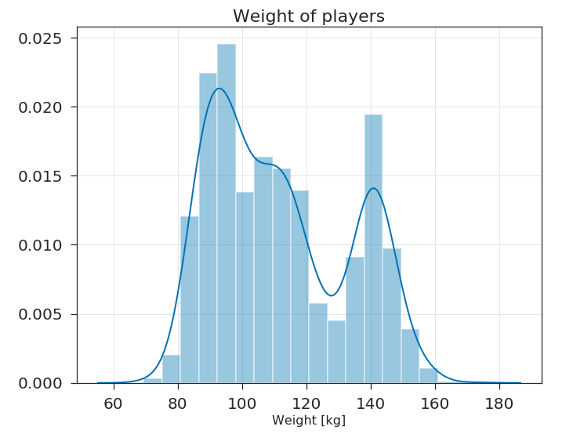
PLOT DATA VARIABLE WEIGHT
plt.figure()
sns.distplot(players["Weight"])
plt.xlabel("Weight [kg]")
plt.title("Weight of players")
plt.savefig("WeightHist.png")
plt.show()
NFL - BASIC PLAYER INFORMATION

Slide 11
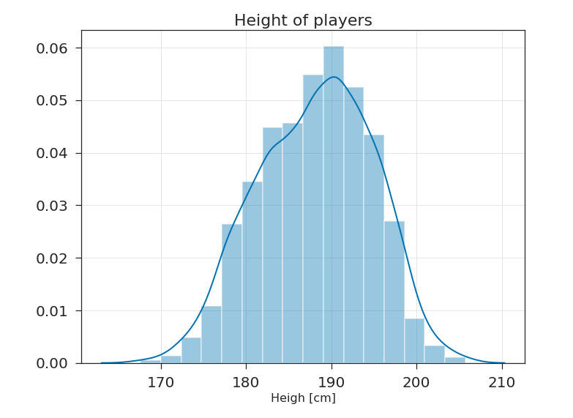
PLOT DATA VARIABLE HEIGHT
plt.figure()
sns.distplot(players["Height"], bins=16)
plt.xlabel("Heigh [cm]")
plt.title("Height of players")
plt.savefig("HeightHist.png")
plt.show()
NFL - BASIC PLAYER INFORMATION

Slide 12
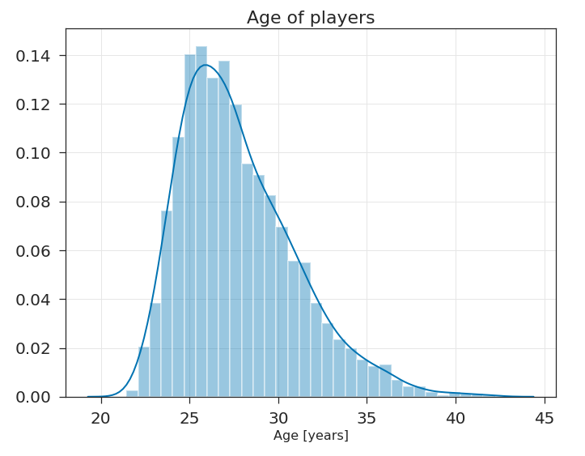
PLOT DATA VARIABLE AGE
plt.figure()
sns.distplot(players["Age"])
plt.xlabel("Age [years]")
plt.title("Age of players")
plt.savefig("AgeHist.png")
plt.show()
NFL - BASIC PLAYER INFORMATION

Slide 13
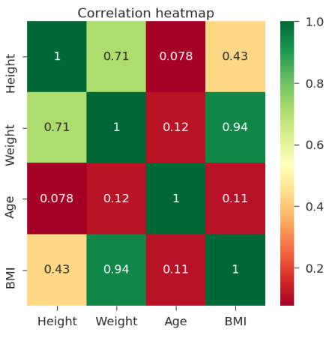
CORRELATION HEATMAP
plt.figure(figsize=(8,8))
sns.heatmap(players.corr(), cmap="RdYlGn", annot=True)
plt.title("Correlation heatmap")
plt.savefig("CorrelationHeatmap.png")
plt.show()
NFL - BASIC PLAYER INFORMATION

Slide 14
N F L
TERIMA KASIH

